Slide 1
Classes and Objects
中央資訊工程系 鄭永斌副教授

Slide 2
Classes and Objects
What is a class ?
  class is just a type
  When you define a class X，you pass another X.h to be included by others.
  Without X.obj, it is still possible for others to compile his module.
  In C++, a class is just like a primitive type INT, CHAR
What is an object?
  When you use a class to create a variable, the variable (along with its allocated memory) is called an object
  A class can have many objects
  Each object has its own memory
  Object is simply memory+behaviors (code)
class Point {
int z ;
public:
int x ;
int y ;
};
Point p,p1 ;
main() {
p.x = 100;
p.y = 200 ;
}

Slide 3
An example
in Dog.h
#ifndef _DOG
#define _DOG
class Dog {
public:
void setAge(int age);
int getAge();
void setWeight(int weight);
int getWeight();
void speak();
private:
int age;
int weight;
};
#endif
#include “Dog.h”
void Dog::setAge(int age)
{
this->age = age;
}
int Dog::getAge()
{
return age;
}
void Dog::setWeight(int weight)
{
this->weight = weight;
}
int Dog::getWeight()
{
return weight;
}
void Dog::speak()
{
cout << "BARK!!" << endl;
}

Slide 4
Constructor & Destructor
In C, 當你使用 struct 時，你只有定義了資料
有時候你還得自己動手做一些初始化的動作
例如
typedef struct dog_body {
int age ;
int weight ;
char *name ;
} Dog ;
假設你事先不能知道 name 的長度。你必須自己想辦法配置空間與初始化
Dog mydog ;
……
// somehow, you got a dog name from input, it is stored in dname
mydog.name = malloc(strlen(dname));
strcpy(mydog.name, dname);
…..
就算別人幫你定義好 Dog的資料結構，很多事情你得自己來，或者是負責定義資料結構的人好心幫你多寫許多的 與 Dog 有關的 function，但是還是得告訴你要去呼叫
我們希望這些程式能夠在初始化自動幫我們事先完成

Slide 5
Constructor and Destructor
class Dog {
public:
Dog();//Constructor
~Dog();//Destructor
void setAge(int age);
int getAge();
void setWeight(int weight);
int getWeight();
void speak();
private:
int age;
int weight;
};
Dog::Dog()
{
age = 0;
weight = 0;
cout << "Dog Constructor Called" << endl;
}
Dog::~Dog()
{
cout << "Dog Destructor Called" << endl;
}

Slide 6
Using a class (instantiation)
Let’s try it
#include "car.h“
#include <iostream>
using namespace std ;
Car::Car() { cout << "Car is constructed" << endl ; }
Car::~Car() { cout << "Car is destroyed!" << endl;}
//---------------------------------------
#include "car.h"
Car honda ;
main() {
Car camery ;
honda.color = 1 ;
camery.color = 100 ;
}
Output
Car is constructed!
Car is constructed!
Car is destroyed!
Car is destroyed!
Make it a global variable
Make it a local variable

Slide 7
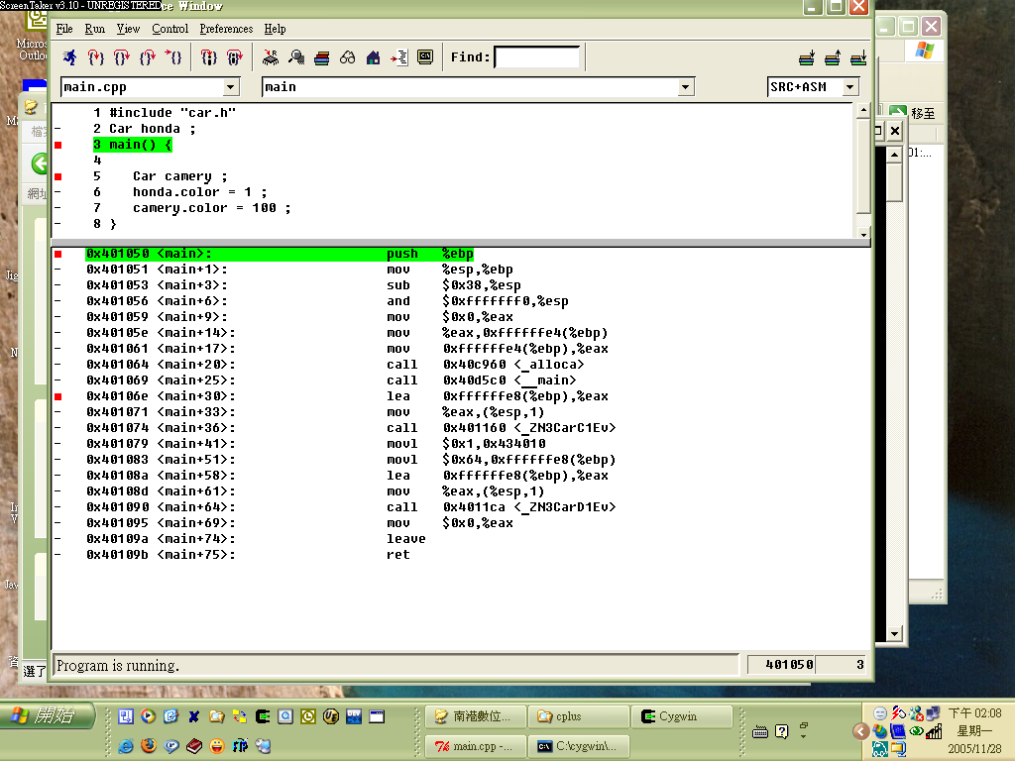
main program initialization
to allocate honda
call Car’s constructor
to allocate a camery
in stack
call Car’s destructor
to deallocate a camery
in stack
A stack access

Slide 8
Comments
So, when is Honda’s destructor is called
Ans:
  after the main program
  There is a piece of code after main() to handle the globally allocated objects

Slide 9
Object allocation
A global variable is allocated at Data Segment
  It disappears (deallocated, destroyed) at the exit of program
A local variable is allocated at Stack
  It disappears at the end of functions (main() is actually a function)

Slide 10

How about Heap object?
#include "car.h“
#include <iostream>
using namespace std ;
Car::Car() { cout << "Car is constructed" << endl ; }
Car::~Car() { cout << "Car is destroyed!" << endl;}
//---------------------------------------
#include "car.h"
Car honda ;
main() {
Car *camery = new Car();
honda.color = 1 ;
camery->color = 100 ;
}
請注意，這裡缺了一個 destroy

Slide 11
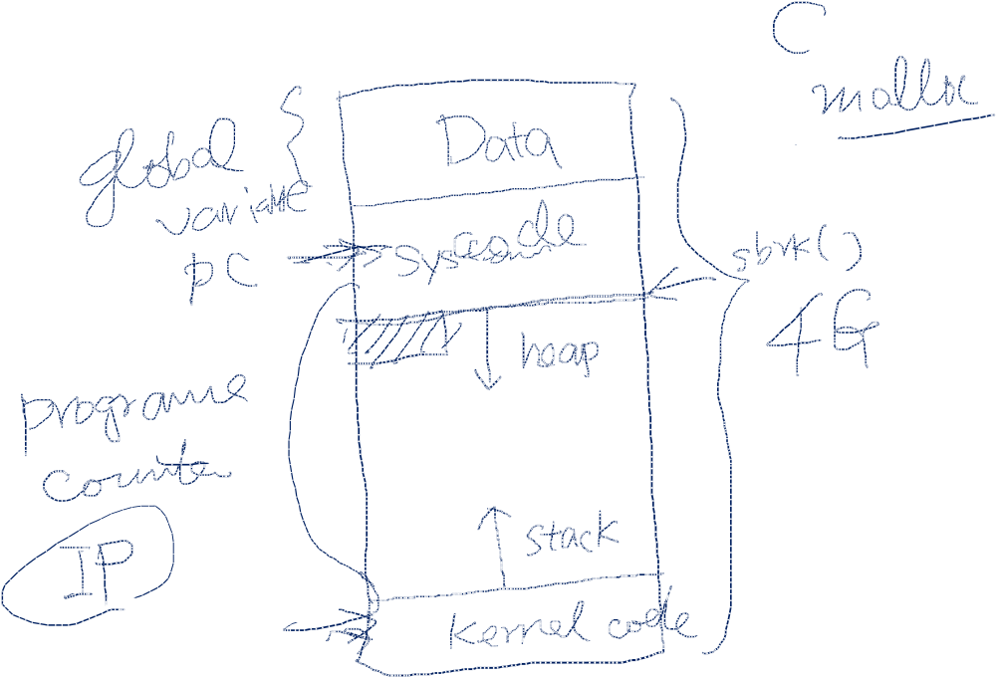

Slide 12
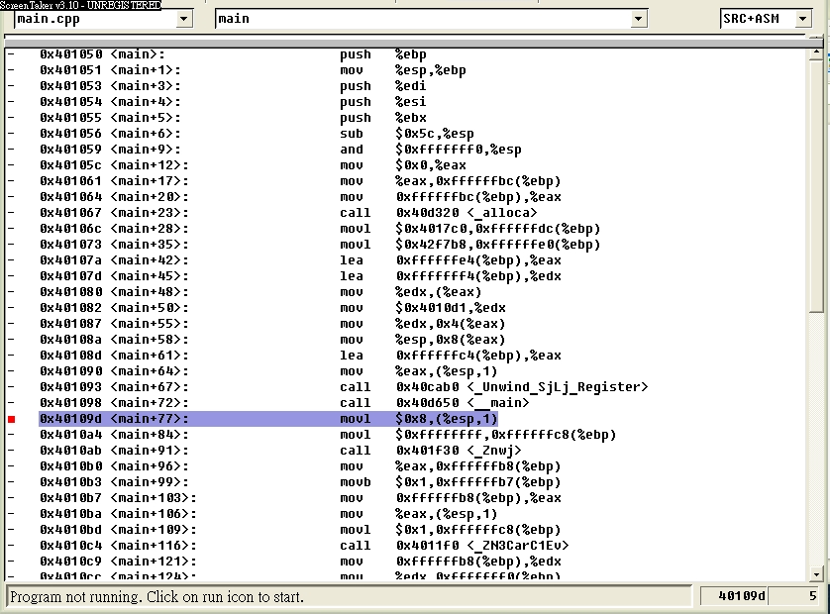

Slide 13
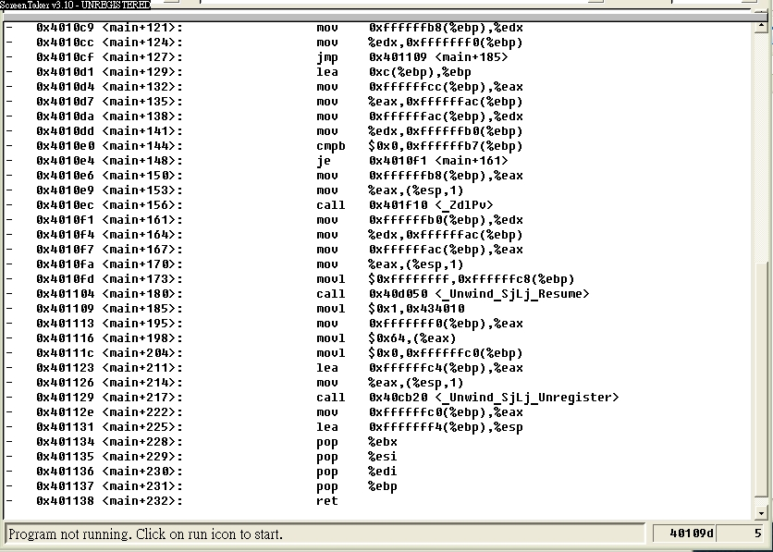
這一段指令都在做
camery = new Car();

Slide 14
What is heap?(自由區，free store)
Heap in a process’s image (let’s rock)
In C,
- use malloc, calloc, free
In C++,
  use new, delete
Be aware of memory leaking

Slide 15
Summary
Just like C, you have 3 places to place your object
  data (life time goes with program)
  stack (life time goes with functions)
  heap (life time vary)

Slide 16
Exercise
下列的程式
Car * foo() {
Car mazda ;
………
return &mazda ;
}

Slide 17
物件的陣列(Object Array in C++)
Table tbl[10] ;
如果一個物件可再不給訂初始參數的情況下被建立出來，就能定義由此class所組成的陣列。
他會建立一個內含10個 table 物件的陣列
delete
  delete[] tbl ;

Slide 18
Dynamic memory allocation
So, now you know objects are created in stack, data, and heap (allocated by new)
a new classification
  statically allocated object
    objects are of fixed, known size and the compiler arranges the required space as it turns source code into a binary or executable program. Statically allocated objects that are of local scope are put into a memory space known as the stack. Statically allocated objects of global scope live in the global address space. The key point is that for these objects their size is fixed at compile time.
  dynamically allocated object
    we don't know the size of an object until program execution. Examples of this are a buffer to hold a block of text of variable size, or an array with an undetermined number of elements

Slide 19
int *IDpt = new int;
float *theMoney = new float;
char *letter = new char;
  The "new" operator returns the address to the start of the allocated block of memory. This address must be stored in a pointer. New allocates a block of space of the appropriate size in the heap for the object. Dynamically allocated memory is accessed indirectly via a pointer. It is possible for new to fail. This will be the case if no memory is available. In this case new throw a "bad_alloc" exception. Exception handling will be discussed in a latter lesson.
int *IDpt = new int;
*IDpt = 5;
int *IDpt = new int(5);// Allocates an int object and initializes it to value 5.
char *letter = new char('J');

Slide 20
Dynamically allocated objects introduce a new twist; they must be explicitly deleted when no longer needed by a program. This is done using the "delete" operator. Delete releases the memory used by the object. That memory is then available for reuse.
delete IDpt;
delete theMoney;
delete letter;

Slide 21
Dynamic allocated array
int *pt = new int[1024];//allocates an array of 1024 ints
double *myBills = new double[10000];
int *pt = new int[1024];//allocates an array of 1024 ints
int *pt = new int(1024);//allocates a single int with value 1024
A dynamically allocated array is best initialized using a loop, as follows.
int *buff = new int[1024];
for (i = 0; i < 1024; i++)
{
buff[i] = 52; //Assigns 52 to each element;
}
free the dynamic allocated objects
delete[] pt;
delete[] myBills;//chapter11() will also release the memory :-)

Slide 22
Usage of Object array
#include <iostream>
#include <string>
using namespace std;
class Cat {
public:
Cat(string name = "tom", string color = "black_and_white") : _name(name), _color(color) {}
~Cat() {}
void setName(string name) {_name = name;}
string getName() {return _name;}
void setColor(string color) {_color = color;}
string getColor() {return _color;}
void speak() {cout << "meow" << endl;}
private:
string _name;
string _color;
};
int main()
{
// Single Argument form of array initialization list
Cat myCats[4] = {"Homer","Marge","Bart","Lisa"};
// Emplicit use of constructors in array initialization list
Cat myOtherCats[3] = {
Cat("Chris","Gray"),
Cat("Charles","White"),
Cat("Cindy","BlueGray")
};
Cat *catpt = new Cat[27];
Cat *pt;
// Use accessor methods to initialize dynamically allocated class objects
pt = catpt;
for (int i = 0; i < 27; i++) {
pt->setName("Felix");// You can never have enough
pt->setColor("Black");// black cats named Felix
pt++;// Can also increment pointer within the for statement
}

Slide 23
Copy constructor and “=“ operator
#include <iostream>
using namespace std;
class Employee {
public:
Employee(char *name, int id);
~Employee();
char *getName(){return _name;}
//Other Accessor methods
private:
int _id;
char *_name;
};
Employee::Employee(char *name, int id)
{
_id = id;
_name = new char[strlen(name) + 1];
//Allocates an character array object
strcpy(_name, name);
}
Employee::~Employee()
{
delete[] _name;
}
int main()
{
Employee programmer("John",22);
cout << programmer.getName() << endl;
return 0;
}

Slide 24
Comments
Employee name is now stored in a dynamically allocated character array. It is of "string length + 1" to allow for the null terminator used with C-style strings, '\0'.
The strcpy function automatically adds the null terminator to the destination string.
Also, notice that the destructor frees the memory used to hold the employee name. This is needed to avoid a memory leak,

Slide 25
int main()
{
Employee programmer("John",22);
cout << programmer.getName() << endl;
//Lots of code ....
Employee manager = programmer;
//Creates a new Employee "manager",
//which is an exact copy of the
//Employee "programmer".
delete programmer ;
return 0;
}
Let’s key in the example and run it
anything wrong?

Slide 27
Comments
The above program contains a serious bug and may die with an exception when run
The problem is that the default member-wise copy constructor is being used to create the "manager" object.
But the member-wise copy copies the address stored in the pointer _name in "programmer" to the pointer _name in "manager".
When you run the above program, programmer's destructor gets called first. It works fine and frees the block in memory. When manager's destructor is called, an exception is thrown when the delete is attempted because that block of memory has already been released.

Slide 28
class Employee {
public:
Employee(char *name, int id);
Employee(Employee &rhs);
~Employee();
char *getName(){return _name;}
int getId() {return _id;}
//Other Accessor methods
private:
int _id;
char *_name;
};
Employee::Employee(char *name, int id)
{
_id = id;
_name = new char[strlen(name) + 1];
//Allocates an character array object
strcpy(_name, name);
}
Employee::~Employee() {
delete[] _name;
}
Employee::Employee(Employee &rhs)
{
_id = rhs.getId();
_name = new char[strlen(rhs.getName()) + 1];
strcpy(_name,rhs._name);
}

Slide 29
Let’s see another example
#include <iostream>
using namespace std ;
class Table {
char *p ;
int sz ;
public:
Table(int s=15) {
p = new char[100] ;
cout << "constructor" << endl ;
}
~Table() { delete[] p ;
cout << "destructor" << endl ;
}
};
void h() {
Table t1 ;
Table t2 = t1 ;
Table t3 ;
t3 = t2 ;
}
main() { h(); }
How many times the default constructor is called?
請問Table預設的建構式被呼叫了幾次？
How many times the default destructor is called ? (Table 的解構式被呼叫了幾次？)
What is the final output?

Slide 30
The Correct Way
class Table {
Table (canst Table&);
Table& operator= (const Table&);
};
Table: : Table (canst Table& t) {
p = new Name [sz=t .sz] ;
for (int i = 0; i<sz; i++)
p [i] = t.p [i];
}
Table& Table: : operator= (const Table& t) {
if (this! = &t) {
delete [] ;
p = new Name [sz=t. sz] ;
for (int i = 0; i<sz; i++) p [i] = t.p [i] ;
}
return * this;
}
絕大部分的情況下
「copy」 operator 與
「＝」 operator 有很大的不同
根本的原因
copy operator 會初始化一塊未經初始化的記憶體
而 ＝ operator 必須妥善處理一個已經建構好的的物件

